Slide 1
Adverse Health Effects associated with Frailty among CKD patients
20180915
Patrick Yihong Wu
總之主要就是要討論在CKD病人中frailty會造成什麼樣的負面健康影響。
Notes:
Under CKD
Frailty’s relation with (adverse health effect) ABCDE….
心理因素?
下次要整理出表！包含Risk ratio

Slide 2
Thoughts
闡述關係：
Frailty – comorbidities
Frailty – mortality
Comorbidities – mortality

Slide 3
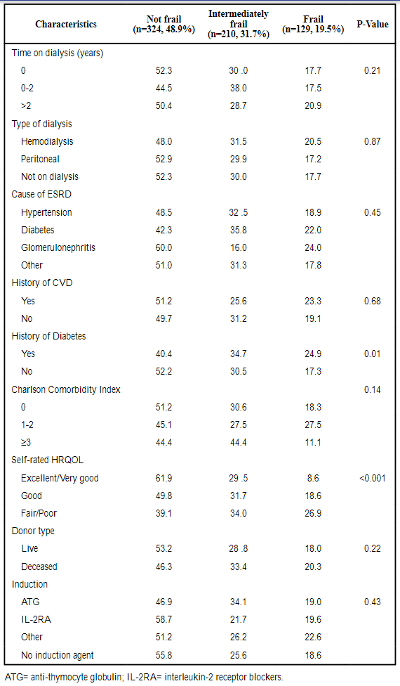
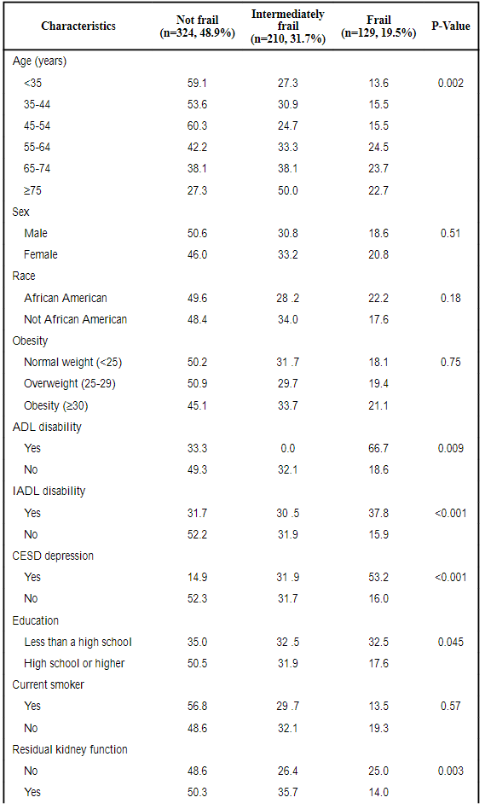
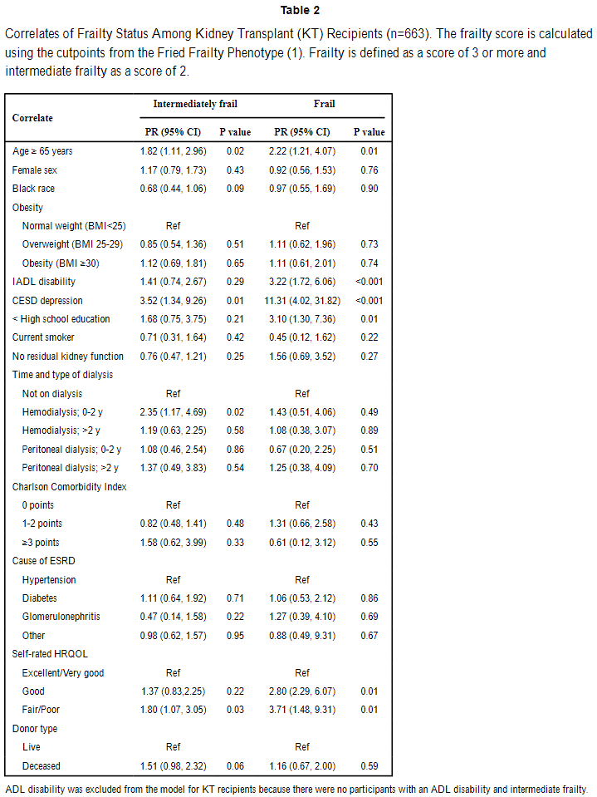
Summary
Reference | Group/Method | Probable Comorbidities
McAdams-DeMarco, M. A. et al. (2017). Individual Frailty Components and Mortality in Kidney Transplant Recipients. Transplantation, 101(9), 2126-2132. doi:10.1097/TP.0000000000001546 | 663 KT recipients enrolled in cohort study of frailty in transplantation (12/2008-8/2015) / (1)Frailty, (2)ADL/IADL disability, (3)CESD depression, (4)education, and (5)HRQOL were measured. Multinomial regression is used to identify frailty correlates. Which patterns of the 5 components were associated with mortality were identified using adjusted Cox proportional hazards models. | Independently associated with frailty: IADL disability (基本日常生活活動功能[activity of daily living，ADL]、工具性日常生活活動功能[instrumental activity of daily living，IADL])(3.22, 95%CI:1.72-6.06), depressive symptoms (11.31, 95%CI:3.02-31.82), less than a high school education (3.10, 95% CI:1.30-7.36) and low HRQOL (Health-Related Quality Of Life) (Fair/Poor:3.71, 95%CI:1.48-9.31). poor grip strength,low physical activity and slowed walk speed (19.4%).
McAdams-DeMarco, M. A., Ying, H., Olorundare, I., King, E. A., Haugen, C., Buta, B., . . . Segev, D. L. (2017). Individual Frailty Components and Mortality in Kidney Transplant Recipients. Transplantation, 101(9), 2126-2132. doi:10.1097/TP.0000000000001546

Slide 4
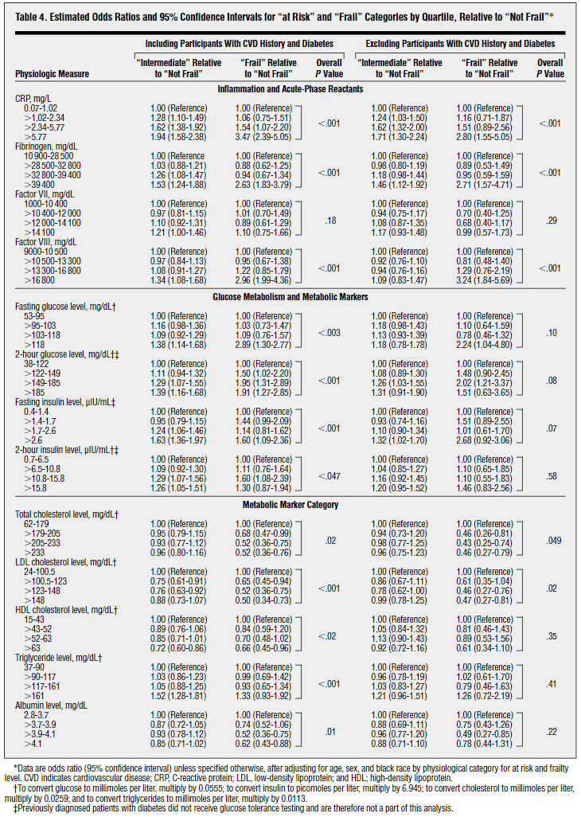
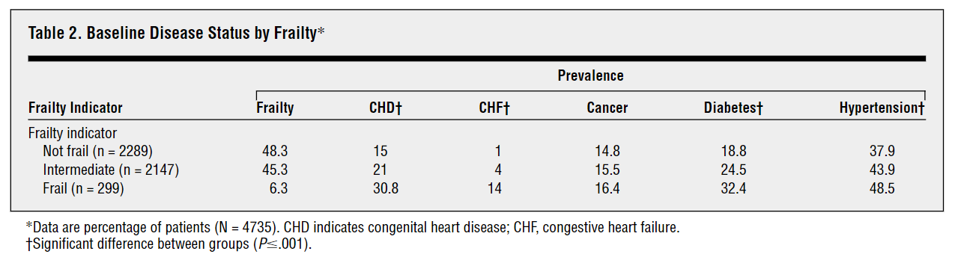
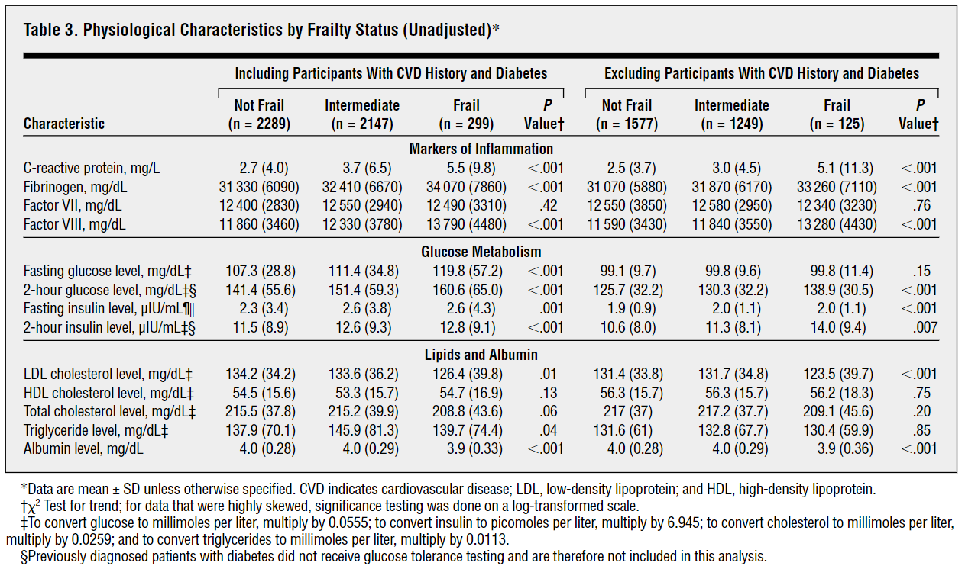
Summary
Reference | Group/Method | Probable Comorbidities
Walston, J. et al. (2002). Frailty and activation of the inflammation and coagulation systems with and without clinical comorbidities: results from the Cardiovascular Health Study. Archives of internal medicine, 162(20), 2333-2341. | 4735 community-dwelling adults 65 years and older. Cardiovascular Health Study (CHS) / Bivariate relationships between frailty level and physiological measures were evaluated by Pearson χ² tests for categorical variables and analysis of variance F tests for continuous variables. Multinomial logistic regression was performed to evaluate multivariable relationships be-tween frailty status and physiological measures. | 跟發炎因子也跟blood-clotting有關！ Frail vs. nonfrail participants had increased mean ± SD levels of: C-reactive protein (5.5 ± 9.8 vs 2.7 ± 4.0 mg/L), factor VIII (13 790 ± 4480 vs 11 860 ± 3460 mg/dL), and, in a smaller subset, D dimer (647 ± 1033 vs 224 ± 258 ng/mL) (P≦.001 for all, χ² test for trend). [D-dimer (or D dimer) is a fibrin degradation product (or FDP), a small protein fragment present in the blood after a blood clot is degraded by fibrinolysis. It is so named because it contains two D fragments of the fibrin protein joined by a cross-link.^{[1]}] 文中提及 (Baseline隨著frailty程度而變)： CHD (congenital heart disease) CHF (congenital heart failure)

Slide 5
Summary
Reference | Group/Method | Probable Comorbidities
Chang, S. S., Weiss, C. O., Xue, Q.-L., & Fried, L. P. (2009). Patterns of comorbid inflammatory diseases in frail older women: the Women’s Health and Aging Studies I and II. Journals of Gerontology Series A: Biomedical Sciences and Medical Sciences, 65(4), 407-413. | Women’s Health and Aging Studies I and II & complementary cohorts of community-dwelling women aged 70–79 years from Baltimore, Maryland (n = 620) / Multivariable logistic regression analyses were performed to evaluate the relationships between these diseases and frailty. | Among the frail (11.3%), 15.2% had both depressive symptoms and anemia and 14.5% had pulmonary disease and anemia. The risk of frailty was synergistically increased in those with depressive symptoms and anemia (adjusted risk ratios = 11.93, 95% confidence interval [CI] 4.10–34.76) and those with pulmonary disease and anemia (risk ratios = 5.57, 95% [CI] 2.14–14.48), compared with those without either disease in each pair. The attributable proportions of frail cases due to interaction between the diseases of each pair were 0.56 (95% Ci 0.07–1.05) and 0.61 (95% [CI] 0.18–1.05), respectively.

Slide 6
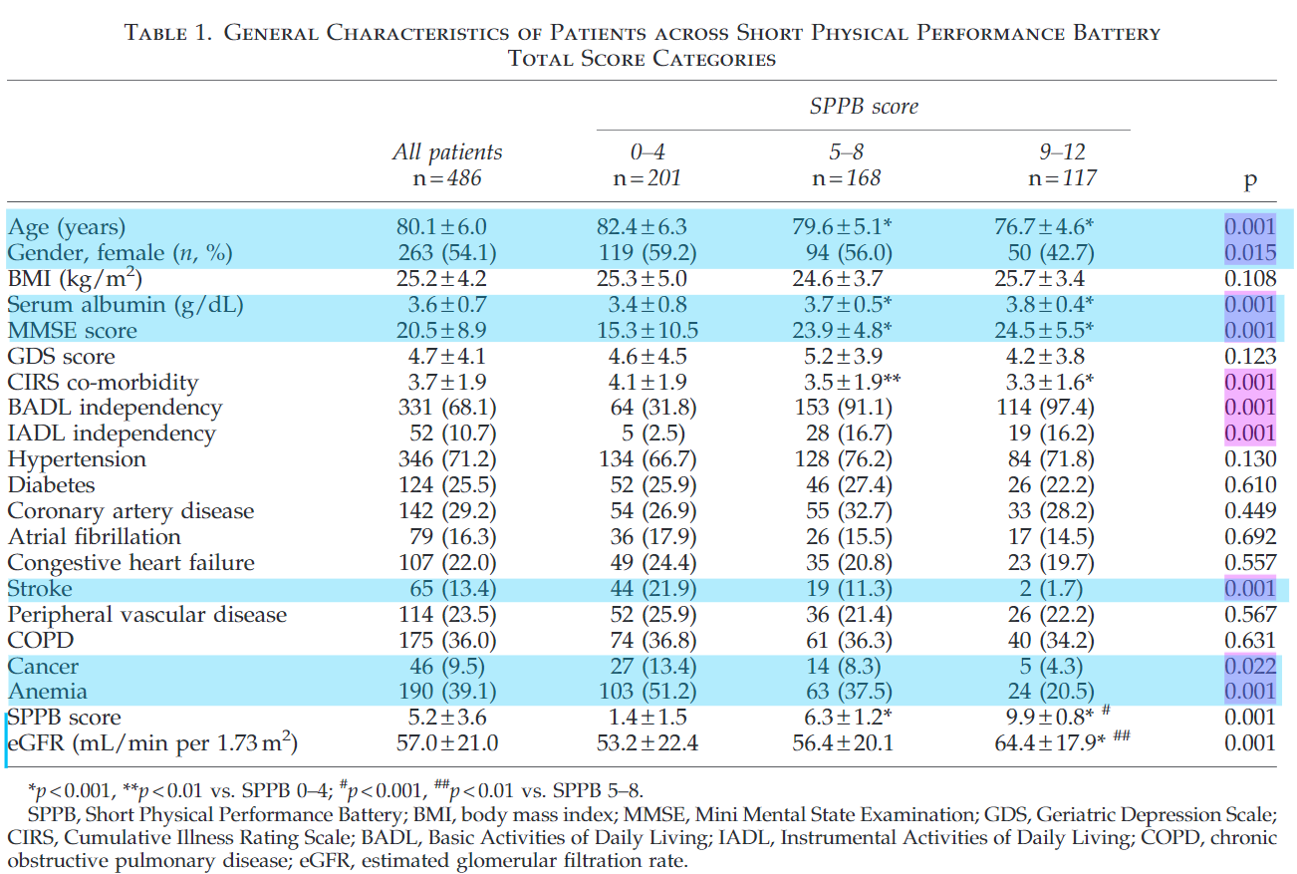
Summary
Reference | Group/Method | Probable Comorbidities
Lattanzio, F., Corsonello, A., Abbatecola, A. M., Volpato, S., Pedone, C., Pranno, L., . . . Antonelli Incalzi, R. (2012). Relationship between renal function and physical performance in elderly hospitalized patients. Rejuvenation Res, 15(6), 545-552. doi:10.1089/rej.2012.1329 | Italian Study Our series consisted of 486 patients aged 65 or more consecutively enrolled in 11 acute care medical wards participating to a multicenter observational study. / The present study used data from a collaborative multi-center study, the PharmacosurVeillance in the elderly Care (PVC), based in community and university hospitals throughout Italy and aimed at surveying drug consumption, occurrence of adverse drug reactions, and quality of hospital care. All patients and/or their relatives/caregivers were contacted by telephone to program every follow-up visit. | Physically impaired patients (SPPB total score < 5), compared to those with intermediate (SPPB = 5–8) and good physical performance (SPPB = 9–12), were: older, had lower serum albumin and Mini-Mental State Examination (MMSE) scores as well as higher overall co-morbidity, prevalence of stroke, cancer, and anemia

Slide 7
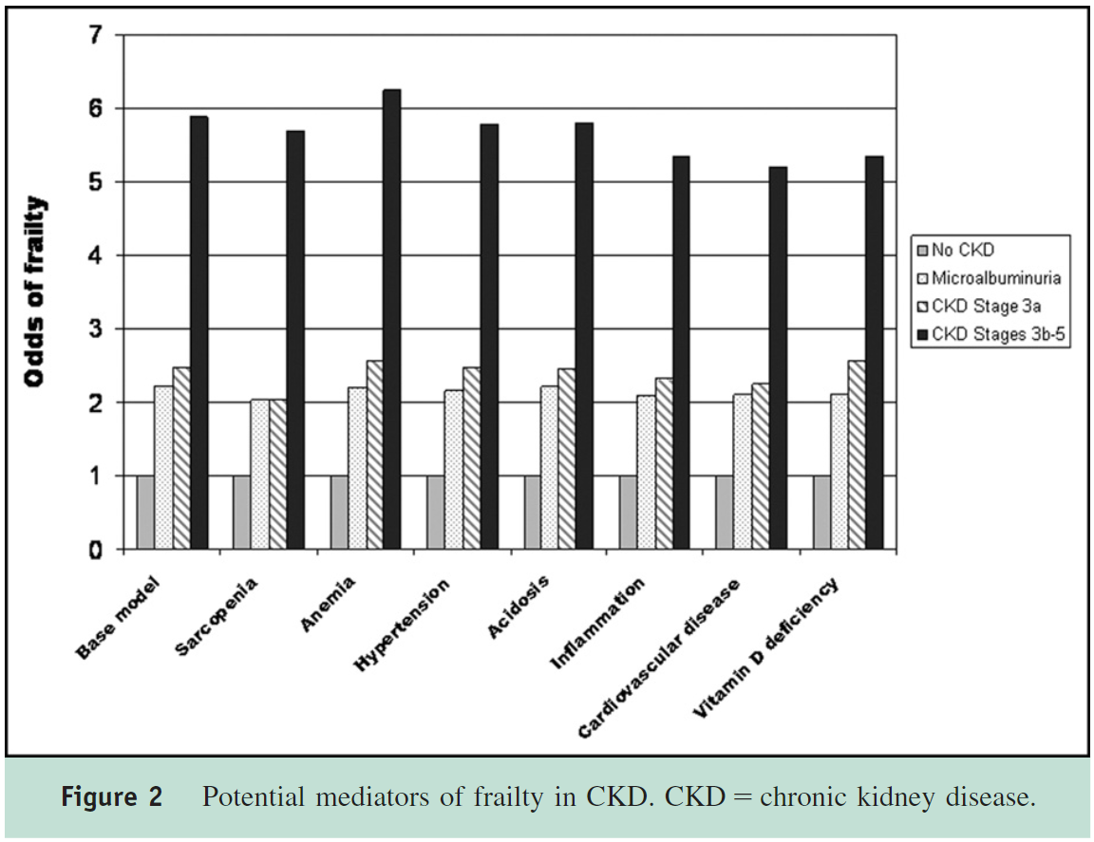
Summary
Reference | Group/Method | Probable Comorbidities
Wilhelm-Leen, E. R., Hall, Y. N., M, K. T., & Chertow, G. M. (2009). Frailty and chronic kidney disease: the Third National Health and Nutrition Evaluation Survey. Am J Med, 122(7), 664-671 e662. doi:10.1016/j.amjmed.2009.01.026 | NHANES III, a nationally representative survey of the health status of persons residing in the United States collected between 1988 and 1994. NHANES III is a cross-sectional, multistage, strati- fied, clustered probability sample of the US civilian noninstitutionalized population conducted by the National Center for Health Statistics, a branch of the Centers for Disease Control and Prevention. / logistic regression to determine whether and to what degree stages of chronic kidney disease were associated with frailty. We also examined factors that might mediate the association between frailty and chronic kidney disease. | Determine the relationship of frailty with CKD. And also determine the mediator of frailty in CKD: Sarcopenia Anemia Hypertension Acidosis Inflammation Cardiovascular disease Vitamin D deficiency

Slide 8
Questions
CKD’s relation with C-reactive protein, microalbuminuria, COPD, 25 hydroxy vitamin D (average sample serum level = 29.38; normal = ?), bicarbonate (average sample serum level = 27.62; normal = 23-30)
Mediator of frailty?
Results?
Signs?
Complications? Comorbidities?

